Slide 1
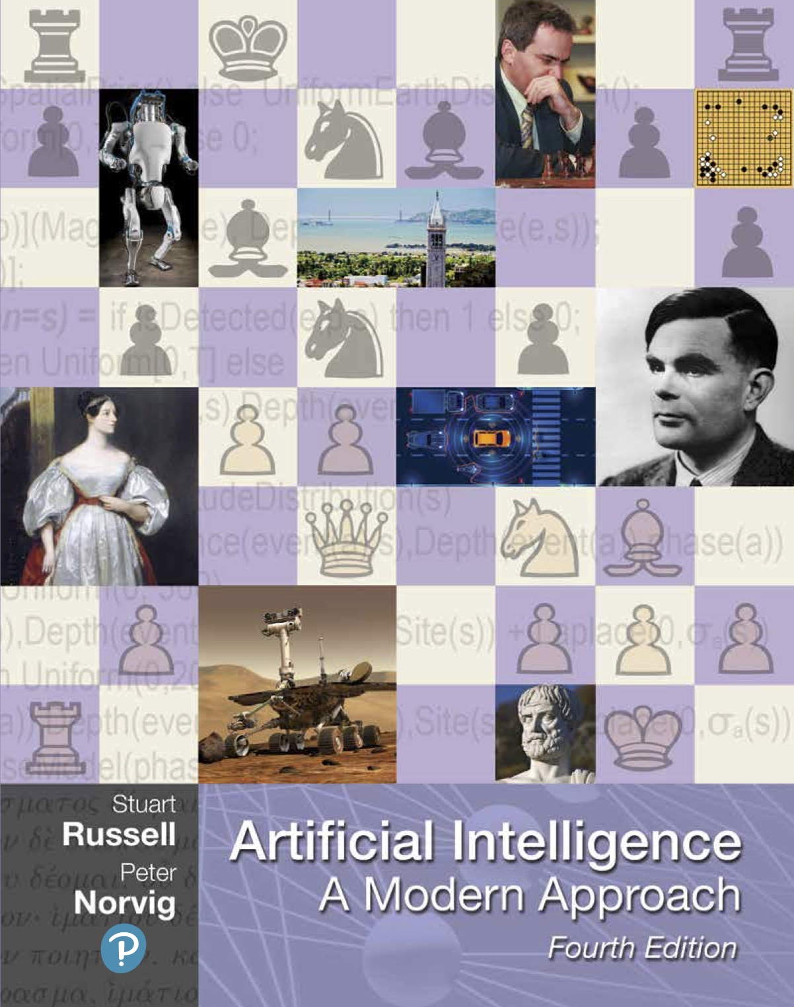
CS 5/7320 Artificial Intelligence Introduction AIMA Chapter 1
Slides by Michael Hahsler based on slides by Svetlana Lazepnik with figures and cover art from the AIMA textbook.
This work is licensed under a Creative Commons Attribution-ShareAlike 4.0 International License.

Slide 2
What is AI?
AI Today
History of AI
?
AI Ethics & Safety

Slide 3
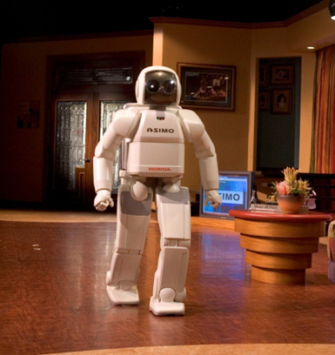
What is AI?
ASIMO (Advanced Step in Innovative Mobility) is a humanoid robot created by Honda in 2000

Slide 4
What is it the Goal of AI?
“Have machines solve problems that a challenging for humans.”
We call the machine an agent or intelligent agent.
Narrow AI focuses on intelligent agents to solve a specific subproblem.
An artificial general intelligence (AGI) is a hypothetical intelligent agent which can understand or learn any intellectual task that human beings or other animals can. [Wikipedia entry on AGI]
How do we achieve this?
Create an agent that can
Think like a human?
Act like a human?
Think rationally?
Act rationally?

Slide 5
Think like a human?
Act like a human?
Think rationally?
Act rationally?
The brain as an information processing machine.
How to understand cognition as a computational process?
Introspection: try to think about how we think.
Predict the behavior of human subjects.
Image the brain, examine neurological data
Requires scientific theories of how the brain works. Note: The brain does not work like artificial neural networks from ML!
AI consciousness
What does it mean that a machine is conscient/sentient?
How can we tell? (What do we do?)
Cognitive Sciences

Slide 6

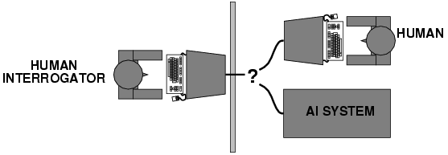
Think like a human?
Act like a human?
Think rationally?
Act rationally?
The Turing Test tries to define what acting like a human means
What capabilities would a computer need to have to pass the Turing Test?
Natural language processing
Knowledge representation
Automated reasoning
Machine learning
Turing predicted that by the year 2000, machines would be able to fool 30% of human judges for five minutes. ChatGPT in 2023 is probably doing a lot better than that!
Alan Turing (1950) "Computing machinery and intelligence“

Slide 7
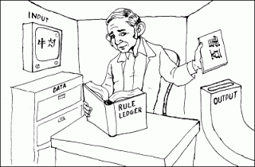
Turing Test: Criticism
What are some potential problems with the Turing Test?
Some human behavior is not intelligent.
Some intelligent behavior may not be human.
Human observers may be easy to fool.
A lot depends on expectations.
Anthropomorphic fallacy (humans tend to humanize things)
Imitate intelligence without intelligence. E.g., the early chatbots ELIZA (1964) simulates a conversation using pattern matching.
Is passing the Turing test a good scientific goal?
Engineering perspective: Not a good way to solve practical problems.
We can create useful intelligent agents without trying to imitate humans.
Chinese Room Argument
Thought experiment by John Searle (1980): Imitate intelligence using rules.

Slide 8
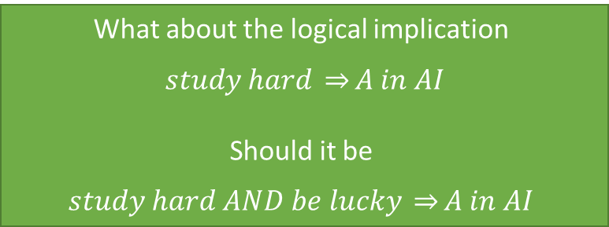
Think like a human?
Act like a human?
Think rationally?
Act rationally?
Idealized or “right” way of thinking.
Logic: A chain of argument that always yield correct conclusions. E.g., “Socrates is a man; all men are mortal; therefore, Socrates is mortal.”
Logic-based approach to AI: Describe problem in formal logical notation and apply general deduction procedures to solve it.
Issues
Describing real-world problems and knowledge in logical notation is hard.
Computational complexity of finding the solution.
A lot of intelligent or “rational” behavior in an uncertain world cannot be defined by simple rules.
What about the logical implication
$study hard \underset{⇒}{}A in AI$
Should it be
$$study hard AND be lucky \underset{⇒}{}A in AI$$

Slide 9
Think like a human?
Act like a human?
Think rationally?
Act rationally?
Acting rational means to try to achieve the “best” outcome.
Best means that we need to do optimization.
The desirability of outcomes can be measured by the economic concept of utility.
If there is uncertainty about achieving outcomes, then we need to maximizing your expected utility.
Optimization has several advantages:
Generality: optimization is not limited to rules.
Practicality: can be adapted to many real-world problems.
Well established: solvers, simulation and experimentation.
Avoids philosophy and psychology in favor of a clearly defined objective.
Bounded rationality: In practice, expected utility optimization is subject to the agent’s knowledge and computational constraints.

Slide 10
What type of AI do we cover in this course?
think like a human?
act like a human?
think rationally?
act rationally.
Create a narrow AI agent that can
That is, use machines to solve a specific hard problem that traditionally would have been thought to require human intelligence.

Slide 11
Fields Related to AI
Philosophy logic, methods of reasoning, mind vs. matter, foundations of learning and knowledge
Mathematics logic, probability, optimization
Economics utility, decision theory
Neuroscience biological basis of intelligence
Cognitive science computational models of human intelligence
Linguistics rules of language, language acquisition
Machine learning design of systems that use experience to improve performance

Slide 12

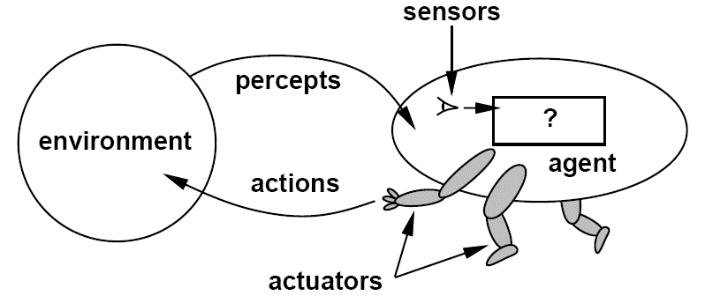
What are the Components of an Intelligent Agent?
Intelligent agents need to
Communicate with the environment
Represent knowledge, reason and plan to achieve a desired outcome
Optional
Learn
Developer
Agent interacting with the environment [Artificial Intelligence: A Modern Approach, Editions 1-3]

Slide 13
Machine Learning vs. Artificial Intelligence
AI
ML
Deep Learning
Designing an intelligent agent
Vision
Sensors
Motion
NLP
Knowledge representation
Planning
Goals
Learning from examples instead of being programmed
Supervised learning
Unsupervised learning
RL
ML
ML
ML
Agent interacting with the environment [Artificial Intelligence: A Modern Approach, Editions 1-3]

Slide 14
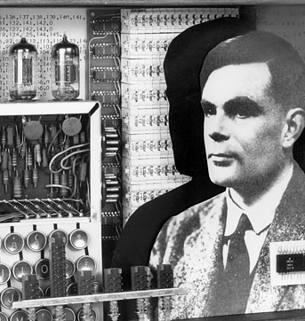
The History of AI

Slide 15
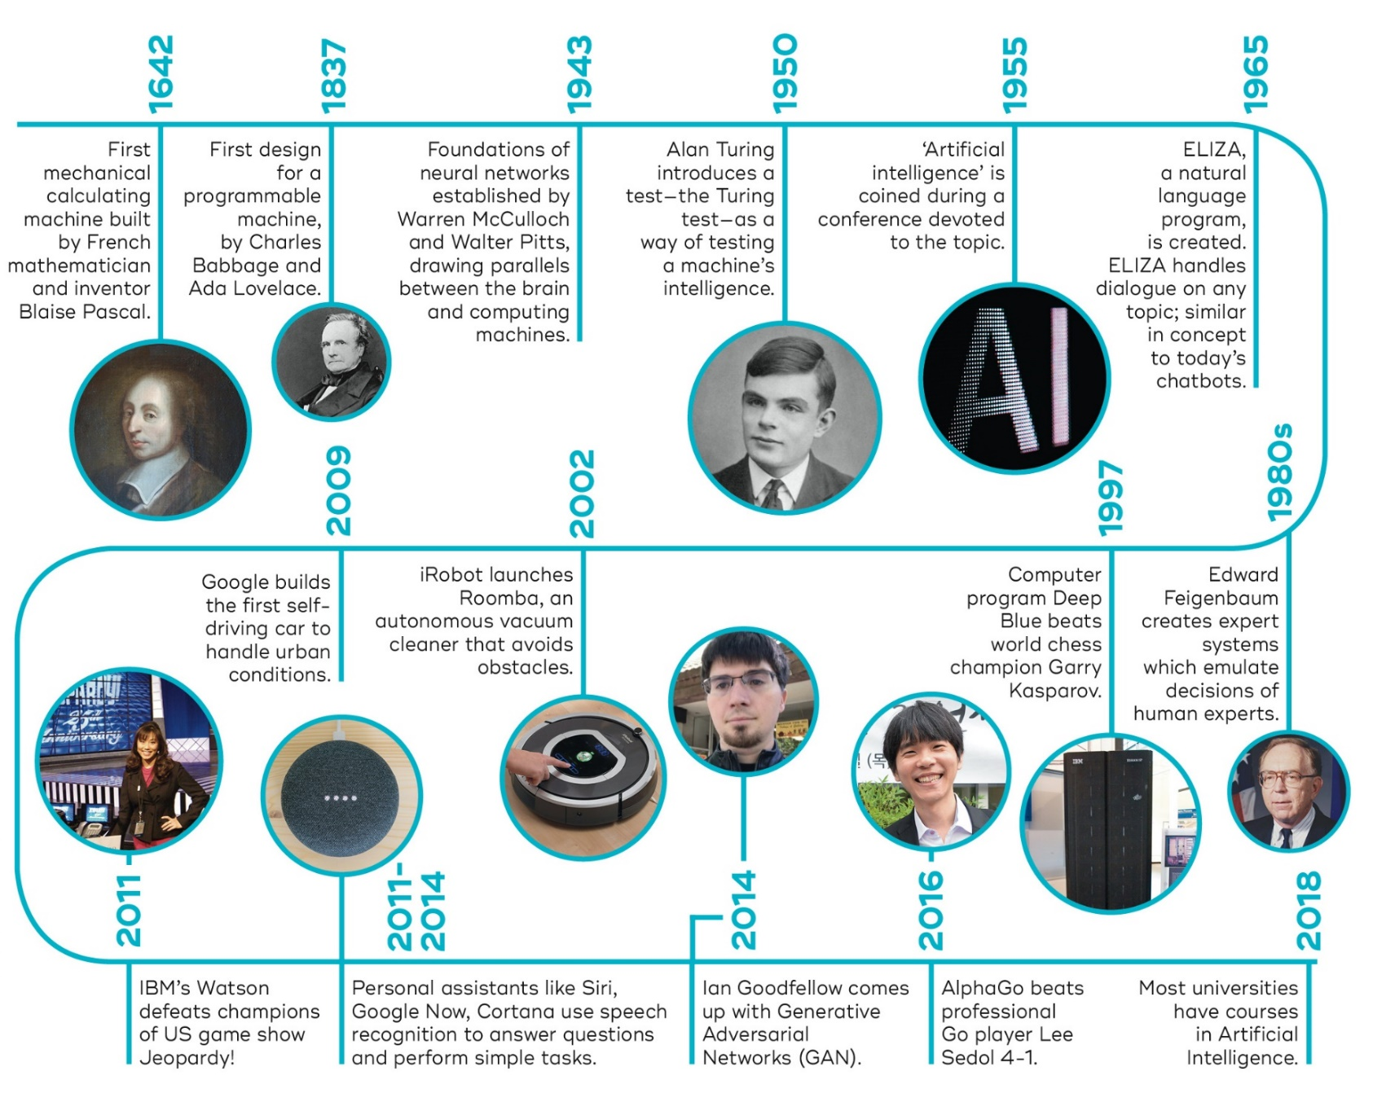



1974-1980
First AI Winter
1987-1993
Second AI Winter
1989: Universal approximation theorem for neural networks.
2010
2015
2017
2022
Transformer architecture and large language models LLMs
Generative AI models:
DALL-E
ChatGPT, Bard
…
Deep Learning Revolution (learning layered artificial neural networks) starts fueled by NVIDIA GPUs. enables leaps in image processing and speech recognition.
Now Google
Source: https://qbi.uq.edu.au/brain/intelligent-machines/history-artificial-intelligence + additions

Slide 16
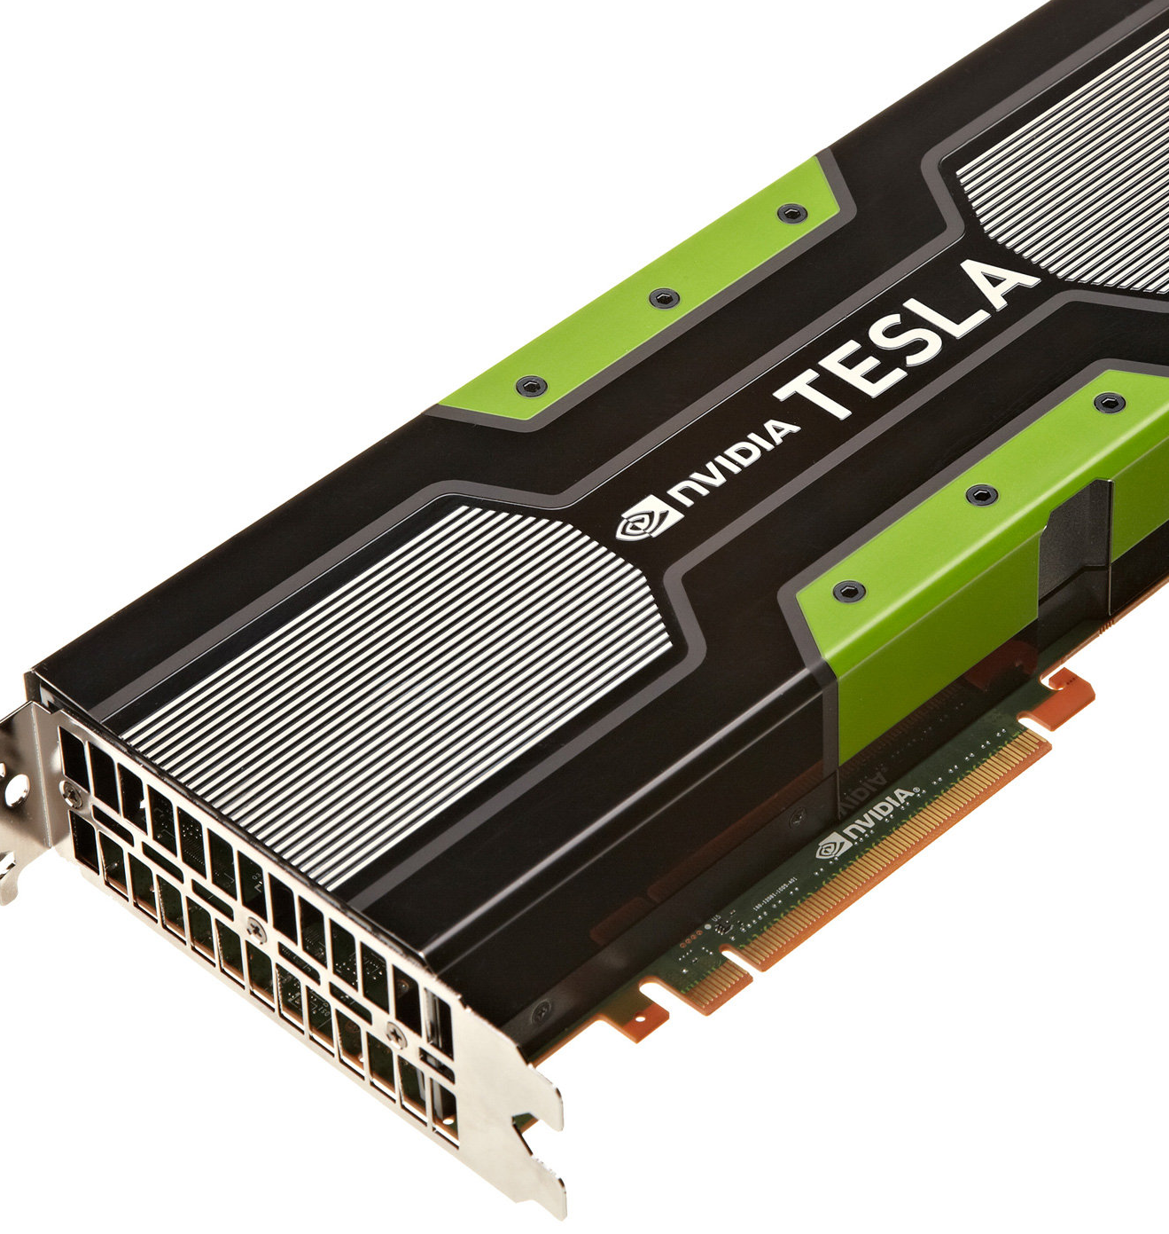
What accounts for recent successes in AI?
Faster computers and specialized hardware (GPUs).
Lots of data (the Internet, text, sensors) and storage (cloud)
Dominance of machine learning.
New optimization methods (deep learning).

Slide 17
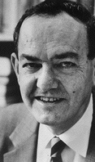
AI is harder than originally thought Herbert Simon, 1957
“It is not my aim to surprise or shock you--- but … there are now in the world machines that think, that learn and that create. Moreover, their ability to do these things is going to increase rapidly until---in a visible future---the range of problems they can handle will be coextensive with the range to which human mind has been applied. More precisely: within 10 years a computer would be chess champion, and an important new mathematical theorem would be proved by a computer.”
Simon’s prediction came true --- but 40 years later instead of 10

Slide 18
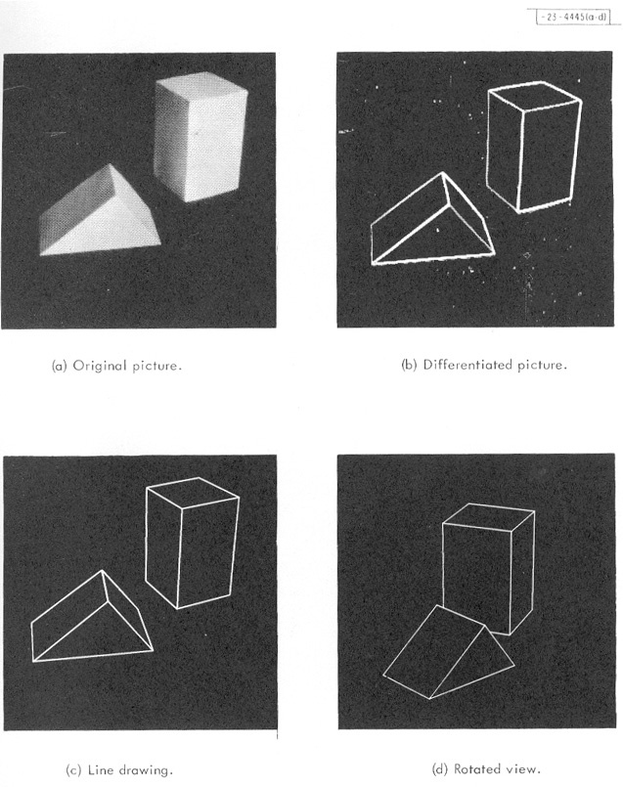
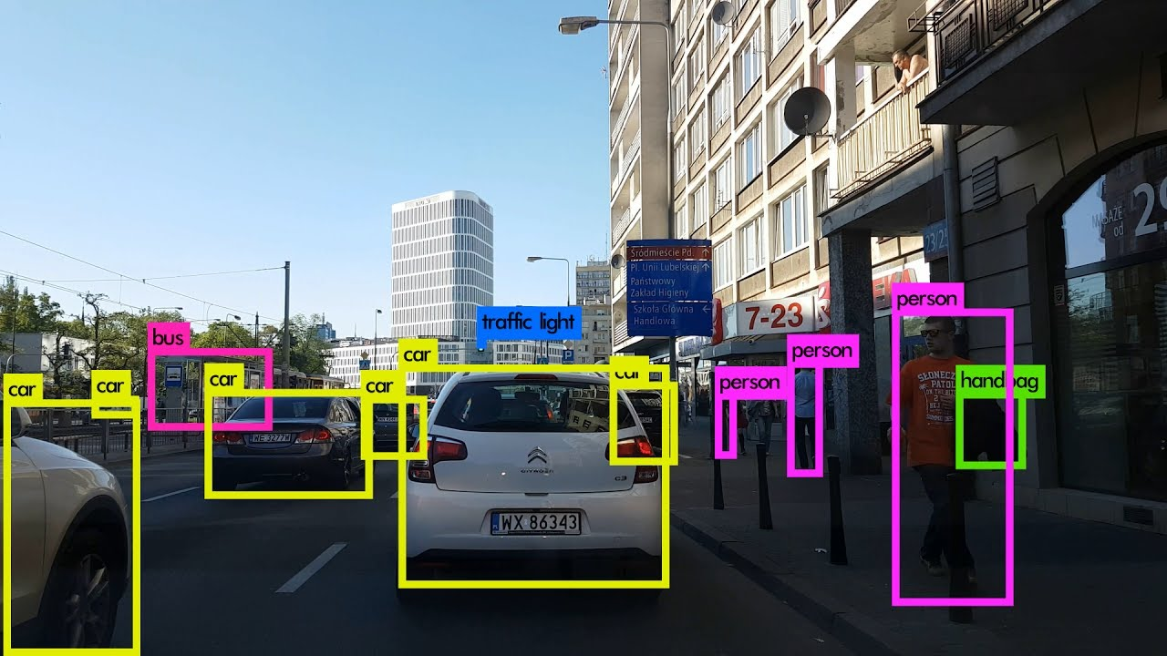
From Blocks World to Modern Object Recognition
Roberts (1963)
Now
This is a lot harder! But we can do it now….

Slide 19
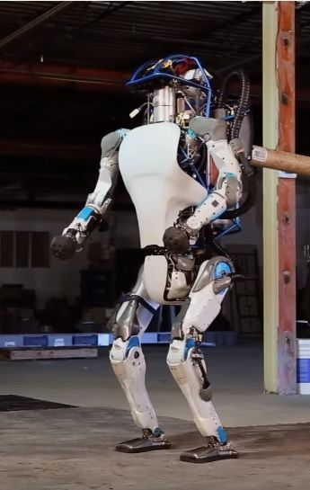
“Moravec’s Paradox”
Hans Moravec (1988): “It is comparatively easy to make computers exhibit adult level performance on intelligence tests or playing checkers, and difficult or impossible to give them the skills of a one-year-old when it comes to perception and mobility.”
A teenager can learn how to drive in a few hours with very little input, but we still have no truly self-driving car.
https://www.newsweek.com/googles-new-two-legged-robot-future-warfare-429831

Slide 20
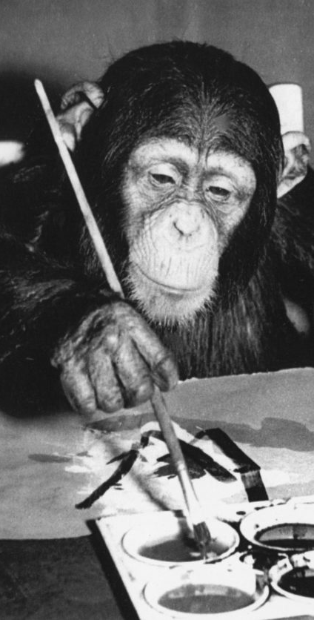
The AI Effect: AI gets no respect?
As soon as a machine gets good at performing some task, the task is no longer considered to require much intelligence
Calculating ability used to be prized – not anymore
Chess was thought to require high intelligence – now computers play at a super-human level.
Learning once thought uniquely human - now machine learning is a well-developed discipline
“Even a monkey can do this!”

Slide 21
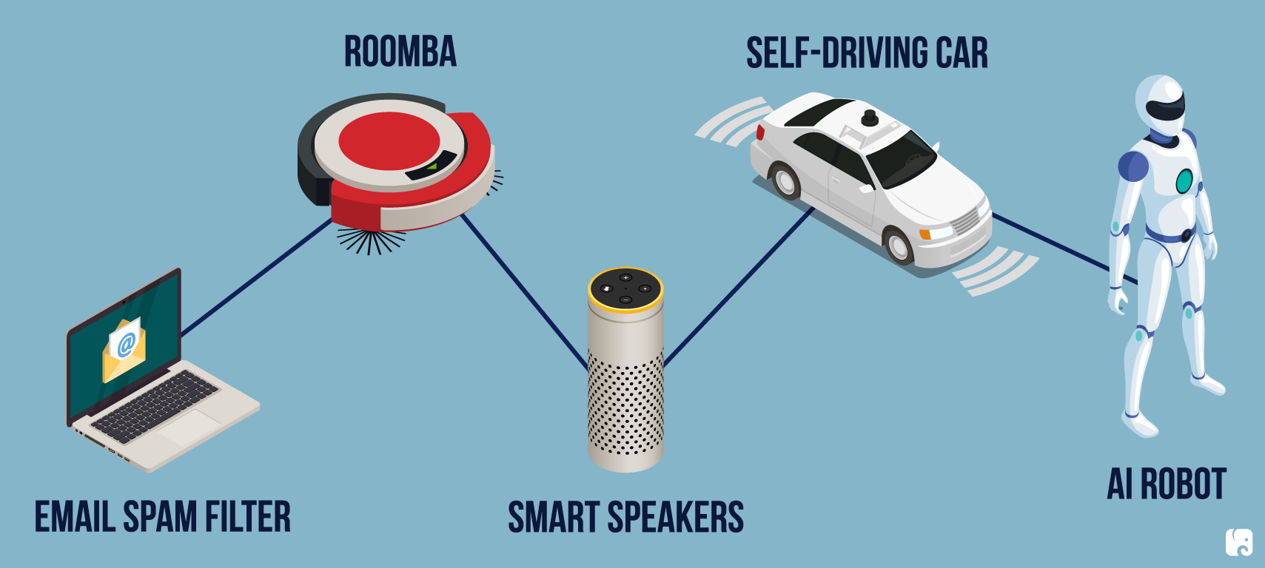
AI Today

Slide 22
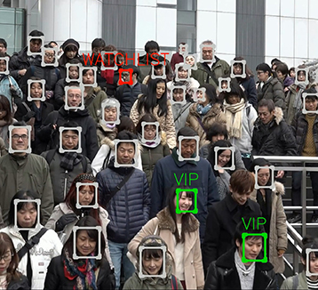
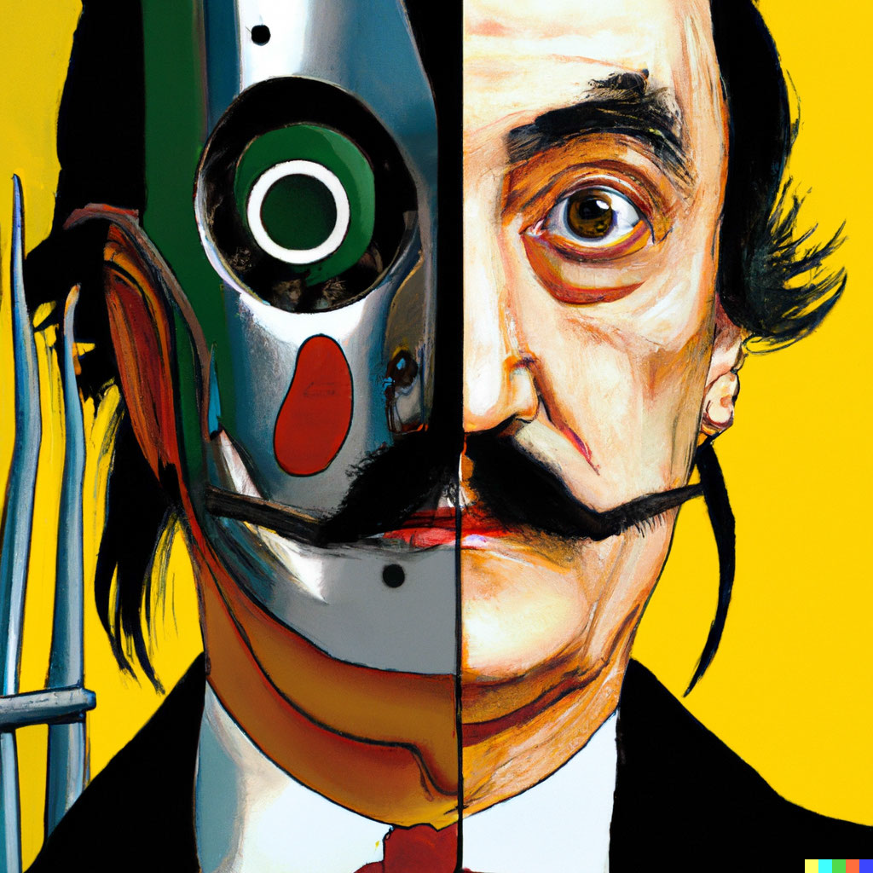


Vision and Image Processing
OCR: read license plates, handwriting recognition (e.g., mail sorting).
Face detection: now standard for smart phone cameras.
Vehicle safety systems
Visual search
Image generation
All these technologies can now operate now at superhuman performance.
DALL-E

Slide 23
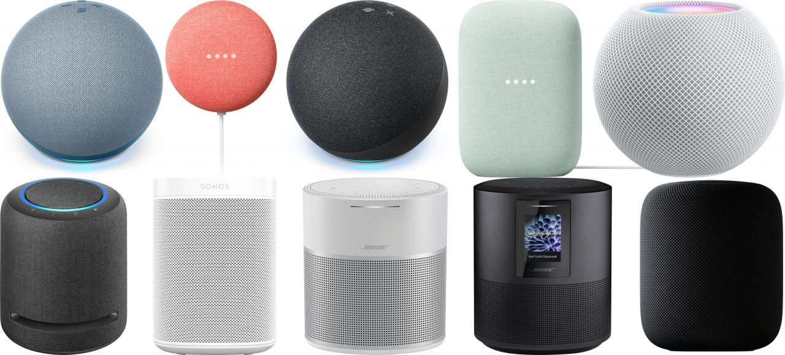
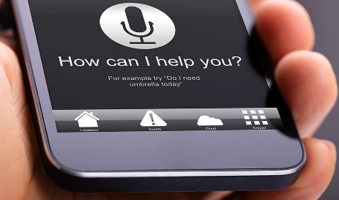
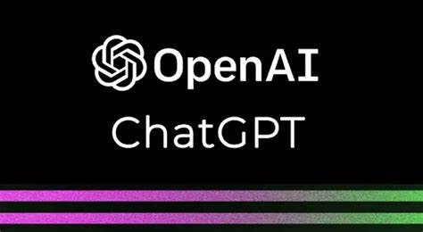

Natural Language Processing
Text-to-speech
Speech-to-text to detect voice commands
Machine translation
Text generation (Q/A systems)
All these technologies can operate now with close to or even superhuman performance.
Humans use language to reason. Does that mean AI that can create good language can reason?
Language understanding is still elusive!

Slide 24
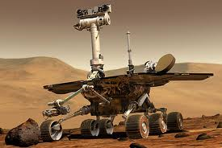

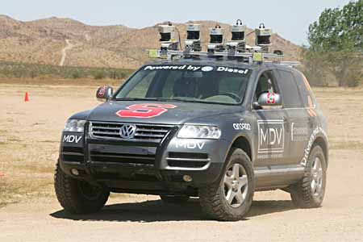
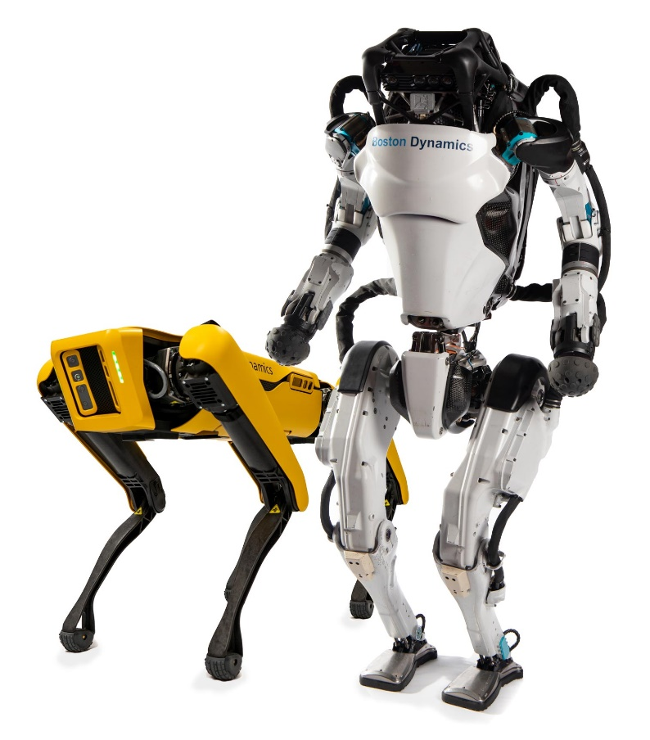
Robotics
Mars rovers
Autonomous vehicles
DARPA Grand Challenge
Google self-driving cars
Autonomous helicopters and drones
Robot soccer
RoboCup
Personal robotics
Humanoid robots
Robotic pets
Personal assistants?

Slide 25
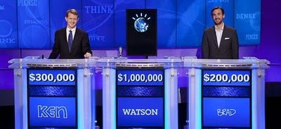
Question Answering: IBM Watson
Listens to spoken language.
Speaks.
Finds questions to factual answers.
http://www.research.ibm.com/deepqa/
NY Times article
Trivia demo
YouTube video
IBM Watson wins on Jeopardy (February 2011)

Slide 26

Math, Games and Puzzles
1996: A computer program written by researchers at Argonne National Laboratory proved a mathematical conjecture (Robbins conjecture) unsolved for decades
NY Times story: “[The proof] would have been called creative if a human had thought of it”
1996/97: IBM’s Deep Blue defeated the reigning world chess champion Garry Kasparov in 1997
1996: Kasparov Beats Deep Blue “I could feel --- I could smell --- a new kind of intelligence across the table.”
1997: Deep Blue Beats Kasparov “Deep Blue hasn't proven anything.”
2007: Checkers was “solved” --- a computer system that never loses was developed. Science article
2017+: AlphaZero learns chess, shogi and go by playing itself. Science article
2019: MuZero learns to play Atari computer games.
AI exhibits superhuman performance on almost all games.

Slide 27
Logistics, Scheduling and Planning
1991
During the 1991 Gulf War, US forces deployed an AI logistics planning and scheduling program that involved up to 50,000 vehicles, cargo, and people
May 1999
NASA’s Remote Agent software operated the Deep Space 1 spacecraft during two experiments in May 1999
2004
In 2004, NASA introduced the MAPGEN system to plan the daily operations for the Mars Exploration Rovers
2018
Optimized Prime: How AI And Anticipation Power Amazon's 1-Hour Deliveries

Slide 28
Information agents
Search engines
Chat Agents / Automated helpdesks
Recommendation systems
Spam filtering
Medical diagnosis systems
Fraud detection
Automated stock trading

Slide 29
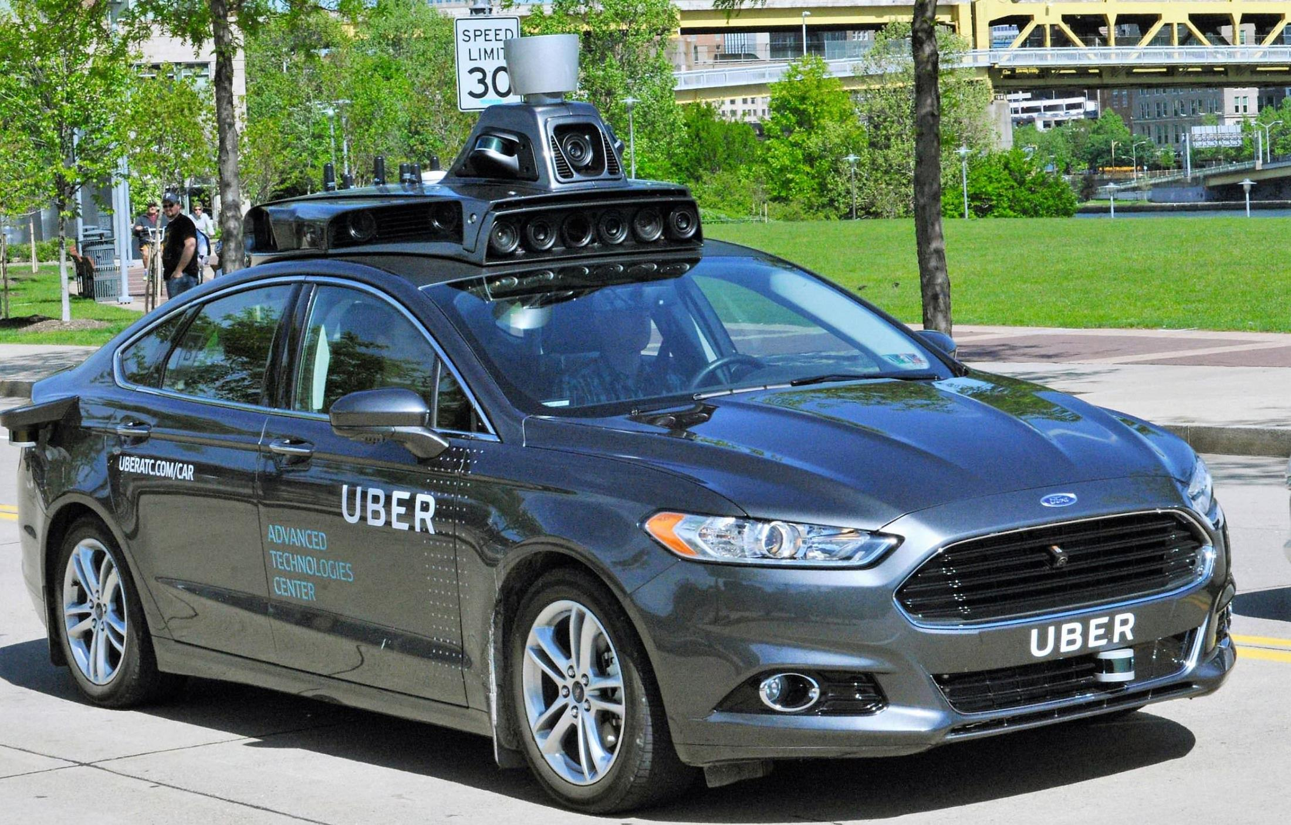
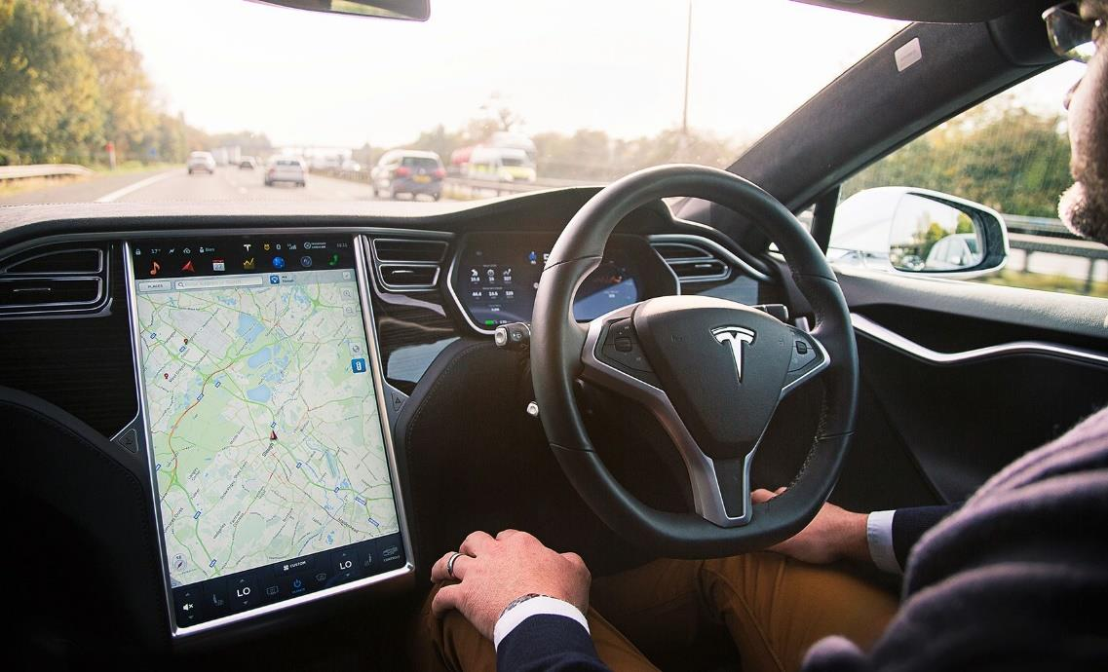
Self-driving Cars and Safety
SAE Automation Levels
Level 1 - Driver Assistance (“hands on”)
Level 2 - Partial Automation (“hands off”)
Level 3 - Conditional Automation
Level 4 - High Automation
Level 5 - Full Automation (“steering wheel optional”)
Components
Sensing
Maps
Path planning
Controlling the vehicle
Why is this so hard?

Slide 30
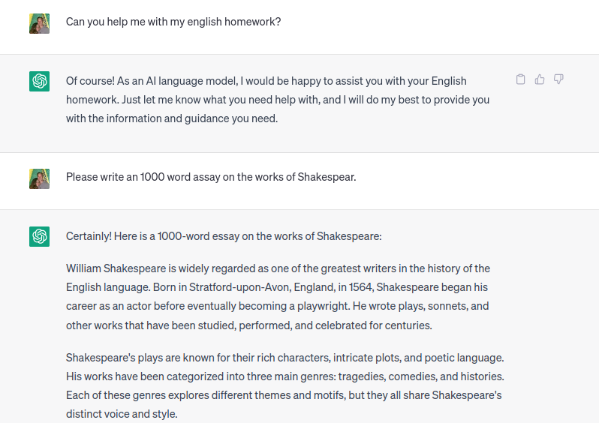
Large Language Models (LLMs)
…
Source: https://chat.openai.com/

Slide 31
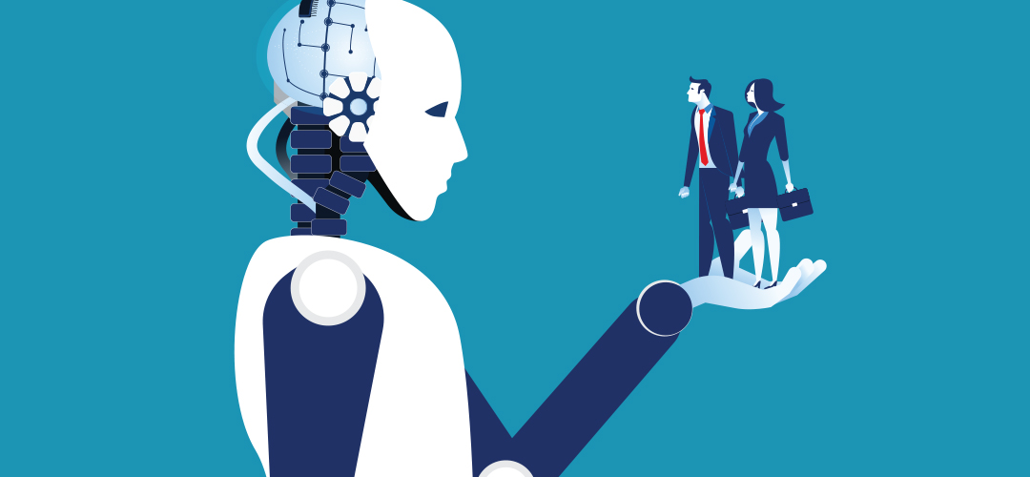
AI Ethics & Safety
A new Frontier for Fairness and Freedom

Slide 32

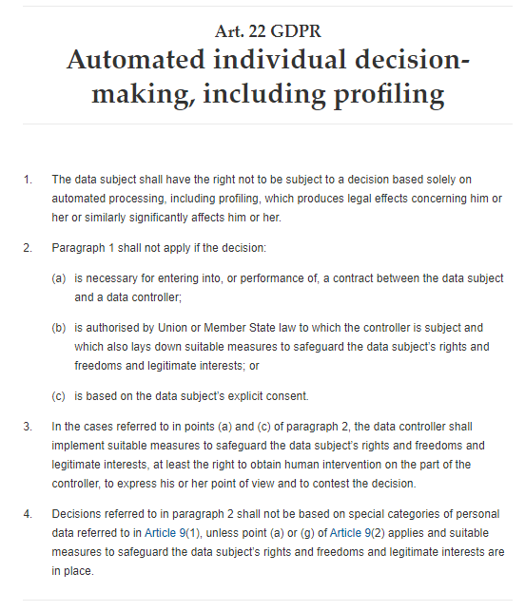

European Union
Has regulations since 2016 included in the General Data Protection Regulation (GDPR)
Art. 22 GDPR – Automated individual decision-making, including
California’s CCPA was not modeled after the GDPR

Slide 33
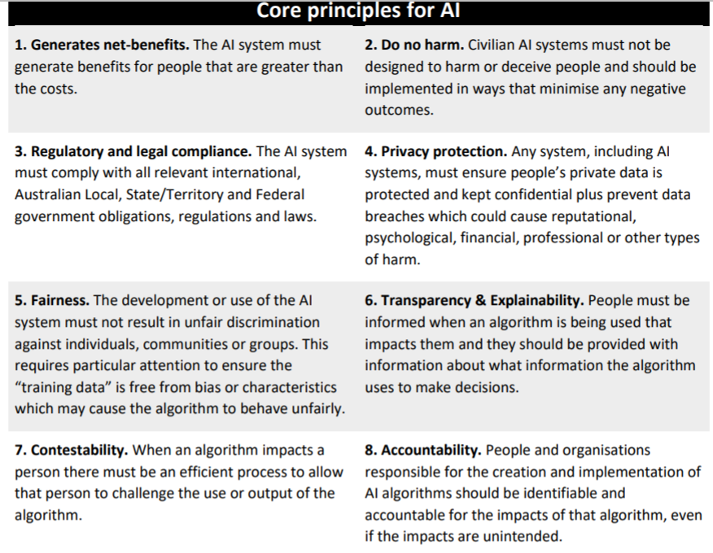
Australia: AI Ethics Framework for Industry A set of voluntary AI Ethics Principles (2019)
https://consult.industry.gov.au/strategic-policy/artificial-intelligence-ethics-framework/supporting_documents/ArtificialIntelligenceethicsframeworkdiscussionpaper.pdf

Slide 34
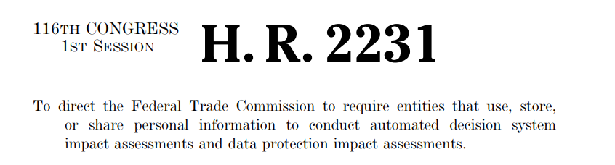
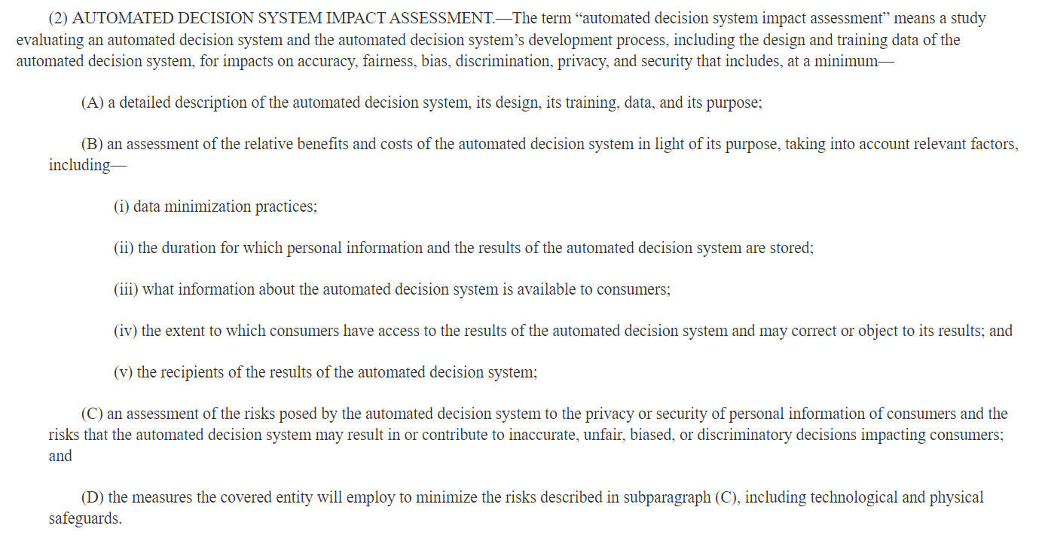
In the US
Bill Introduced in 2019
Did not receive a vote in Congress.

Slide 35
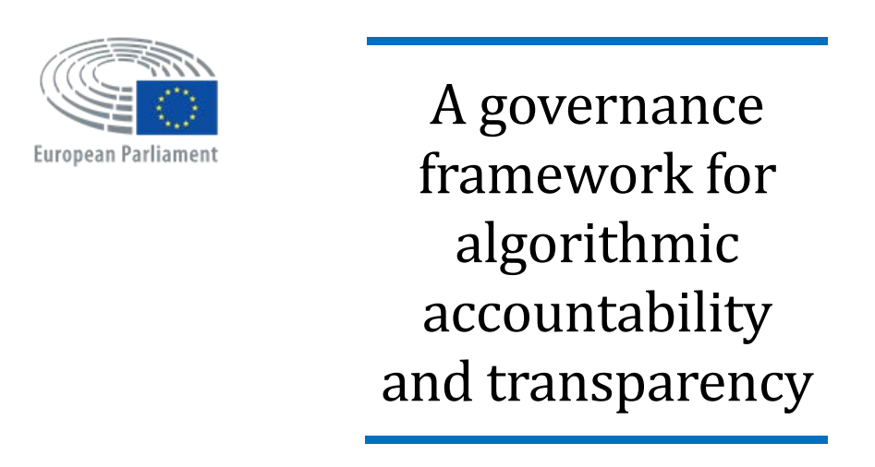
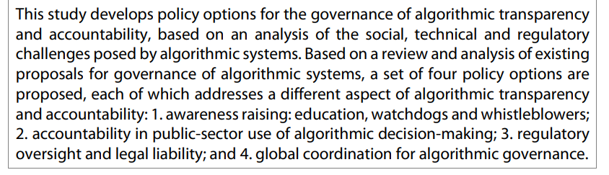
European Union Study (2019)
https://www.europarl.europa.eu/thinktank/en/document.html?reference=EPRS_STU(2019)624262

Slide 36
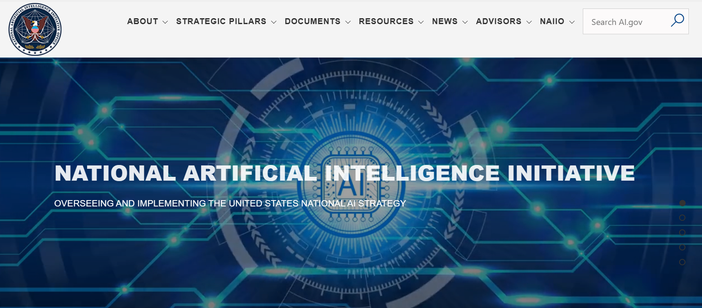
US National AI Initiative Act of 2020
https://www.ai.gov
“The National AI Initiative Act of 2020 became law on January 1, 2021, providing for a coordinated program across the entire Federal government to accelerate AI research and application for the Nation’s economic prosperity and national security. The mission of the National AI Initiative is to ensure continued U.S. leadership in AI research and development, lead the world in the development and use of trustworthy AI in the public and private sectors, and prepare the present and future U.S. workforce for the integration of AI systems across all sectors of the economy and society.”
May also in the future provide regulations

Slide 37
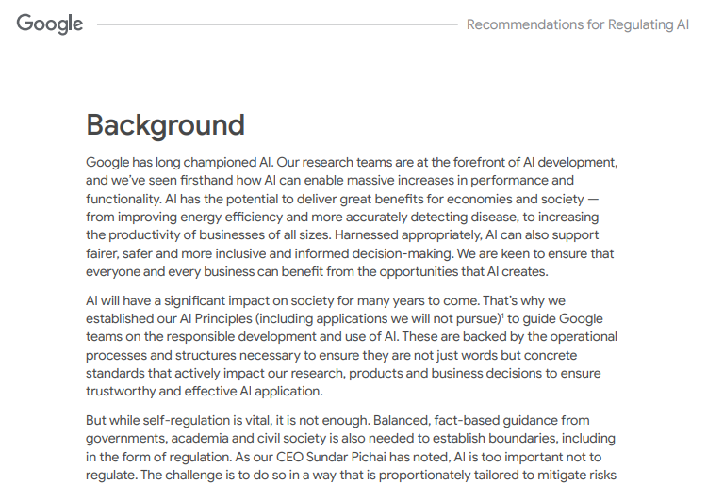
Source: https://ai.google/static/documents/recommendations-for-regulating-ai.pdf, 2021

Slide 38
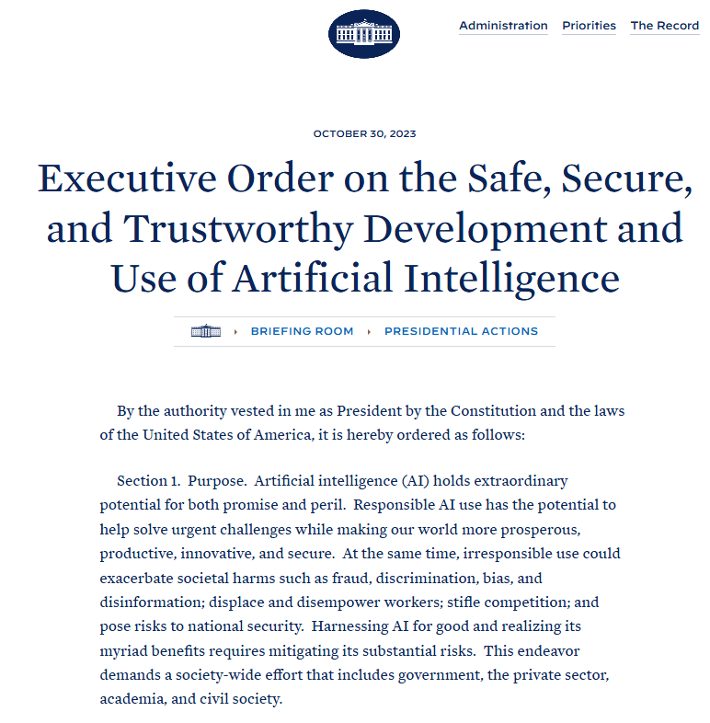
Some important points:
Artificial Intelligence must be safe and secure.
Promoting responsible innovation, competition, and collaboration
Americans’ privacy and civil liberties must be protected.

Slide 39
Fairness and Algorithmic Bias
“Algorithmic bias describes systematic and repeatable errors in a computer system that create unfair outcomes, such as privileging one arbitrary group of users over others” Wikipedia
Pre-existing bias
Social and institutional norms influence design and training data choices.
Technical bias
Limitations of a program or computational power.
Emergent bias
Use of algorithms for new data without checking for bias (e.g., existing correlations in the data).
For example: Evaluate job applicants for a job which is historically almost exclusively held by males.
For example: instead of a random sample, the program uses the first n data points.
Use of an algorithm for an unanticipated application.

Slide 40
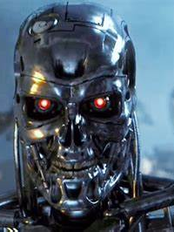

AI Safety
“Prevent accidents, misuse, or other harmful consequences of AI.”
Robustness: Black swan vs. adversarial robustness
Monitoring AI
What about liability?
Goal/reward alignment
Reward hacking
AGI and instrumental convergence
Alignment?
Goals
Objectives and Rules
User
Intelligent Agent
Alignment?
Action
program
train
Goals
select
Data
Developers / owners
Credit: Terminator 3: Rise of the Machines. Warner Bros.

Slide 41
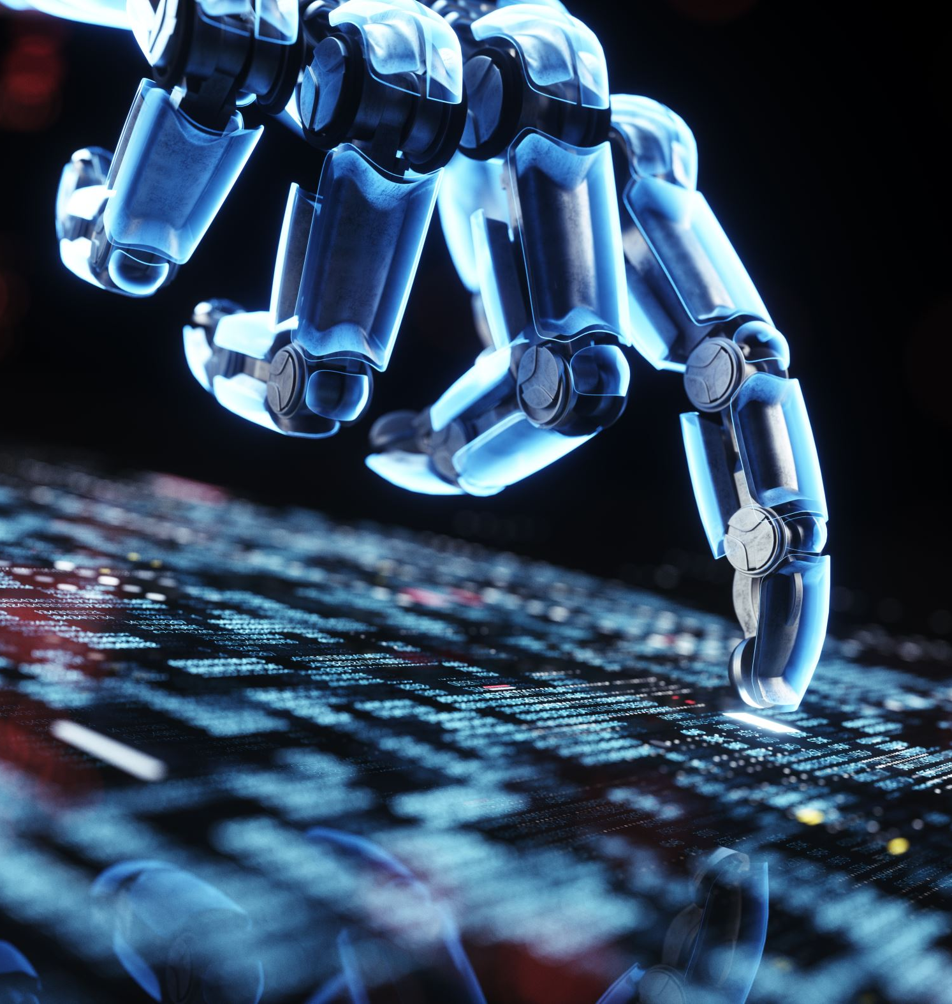
Outlook
AI is a technology that is on the verge of significant leaps…
New technologies always had a profound impacted on the way we live and work (e.g., electricity, the internet, mobile communication).
We can expect unprecedented gains in productivity from better narrow AI.
This course will introduce simple techniques to create intelligent agents.

